Slide 1
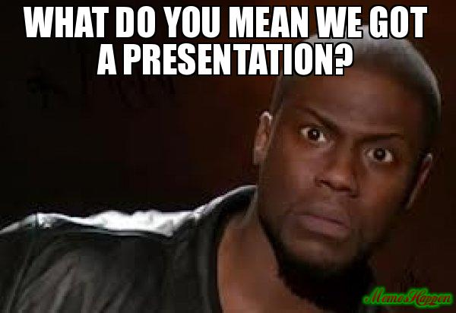

Slide 2
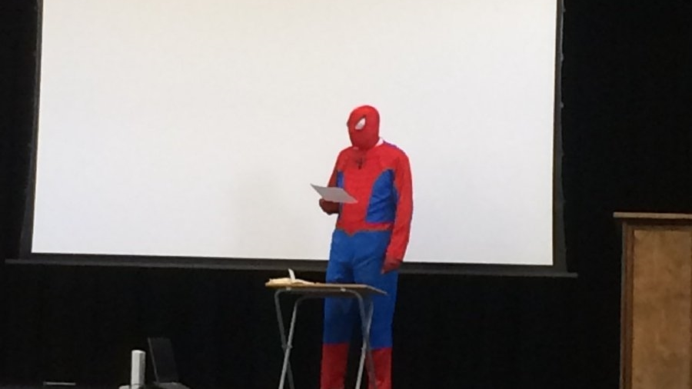
Memes
C044- Amishi Desai
C049- Chahel Gupta

Slide 3
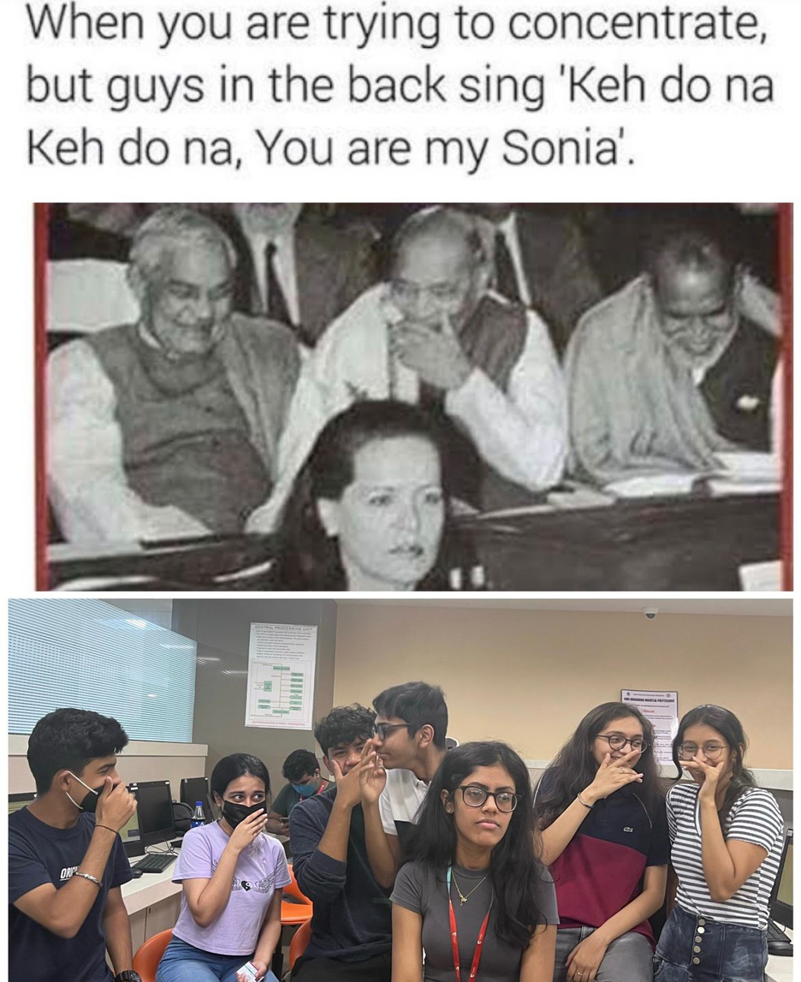

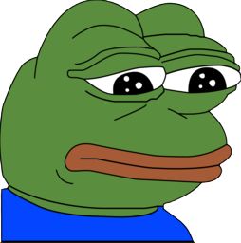
WHAT IS A MEME?
It is a package that conveys the idea of a unit of cultural transmission or a unit of imitation.
This famous term "meme" was coined by evolutionary biologist Richard Dawkins in 1976, while he was attempting to determine why some behaviors were common in human societies.

Slide 4
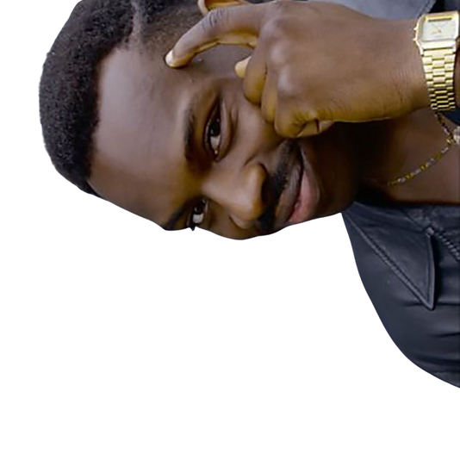
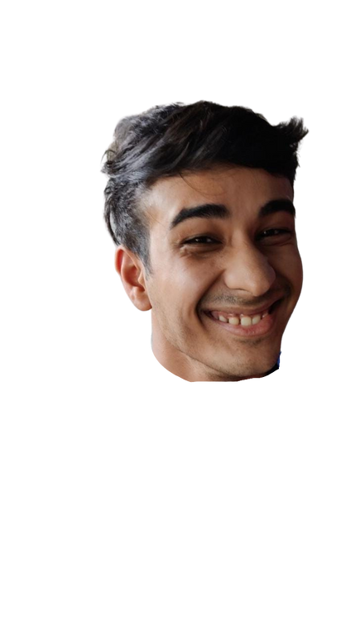
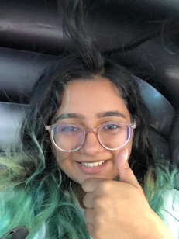
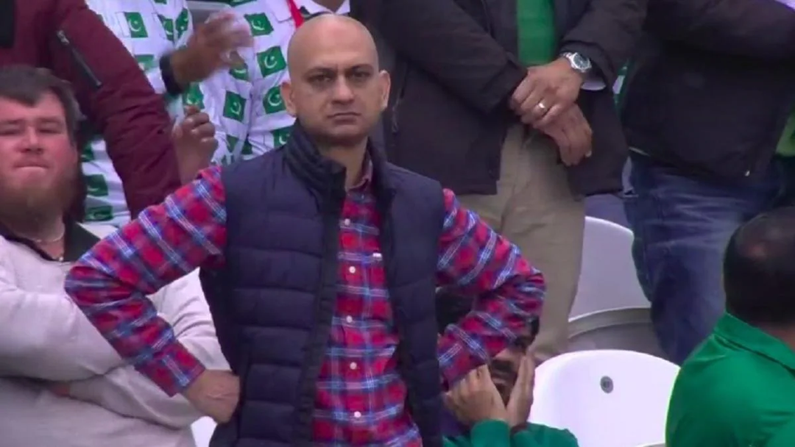
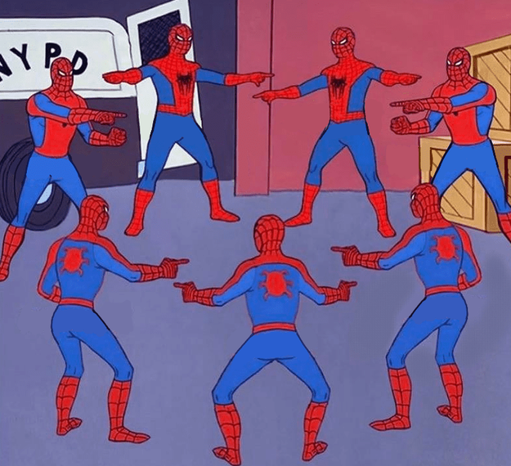

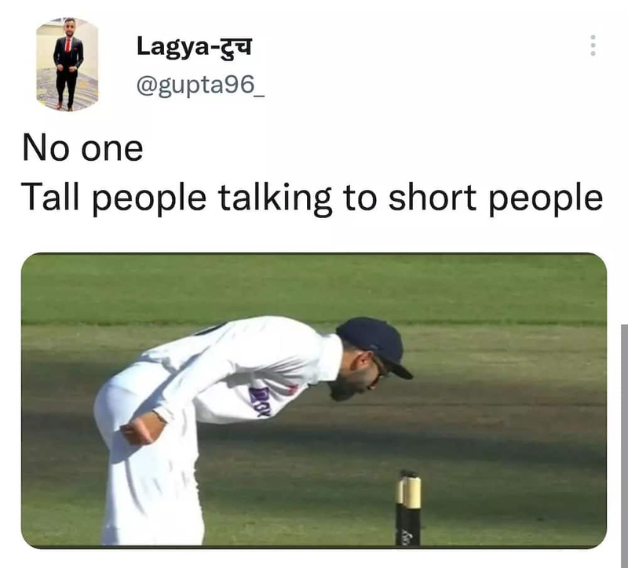
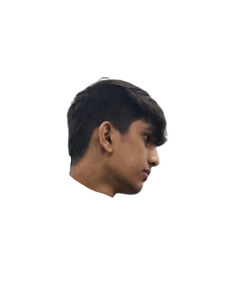

MEMES, MEMES EVERYWHERE
Memes have become our daily life and we don't even notice it.
They are being used in almost every conversation, be it a text message or stickers or posts, and now they are being used by companies and the government as well.
Everyone trying to make new sentences on telegram
C044 AD
@AD_here
No one:
C048 talking to other B2 people:

Slide 5
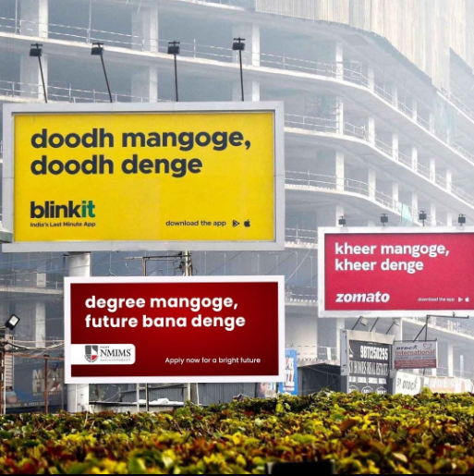
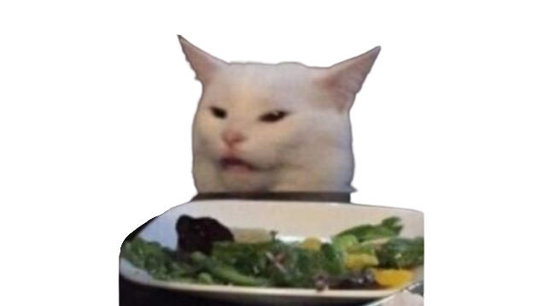
MEME
MARKETING
When a brand’s marketing strategy includes the use of memes, it’s called meme marketing. Meme marketing is no less than an art.
It is an art by which the brands display their discounts, deals, and their promotions in a meme. Then they implant these memes in the meme community.

Slide 6
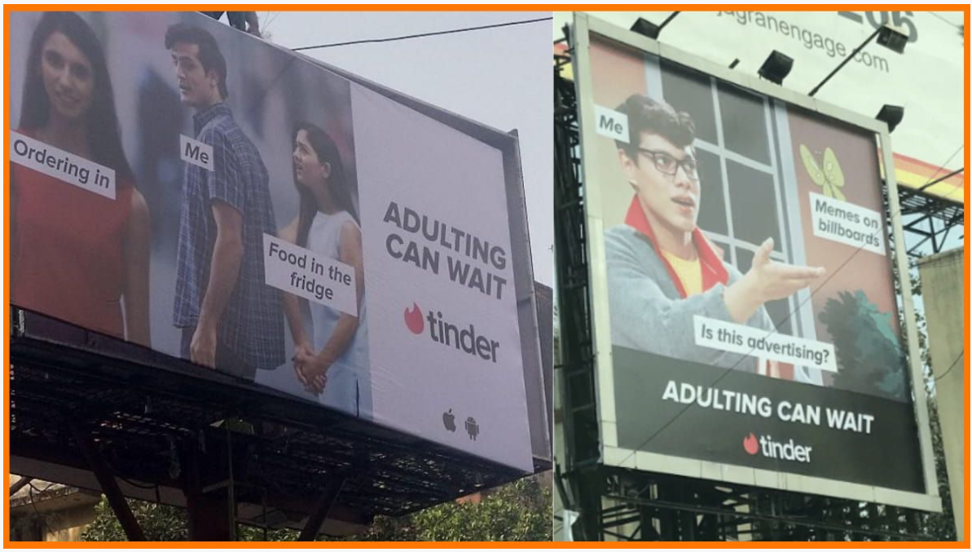

Slide 7
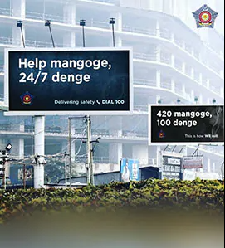
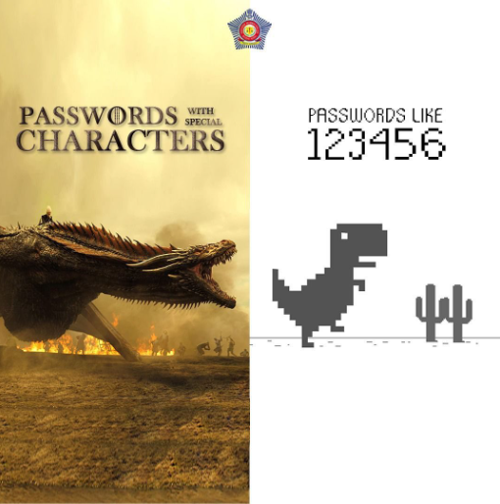
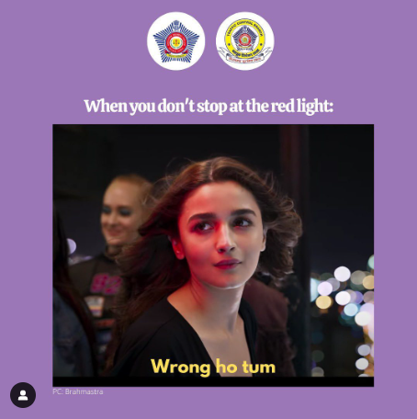
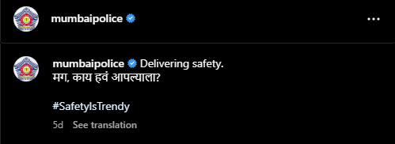
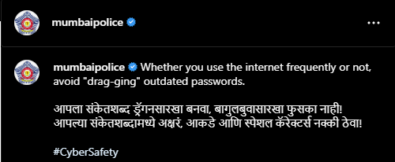
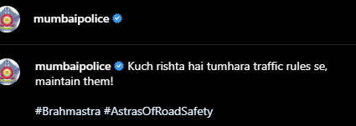
MUMBAI POLICE

Slide 8
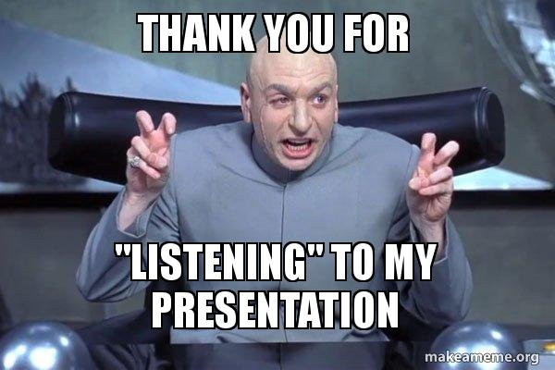
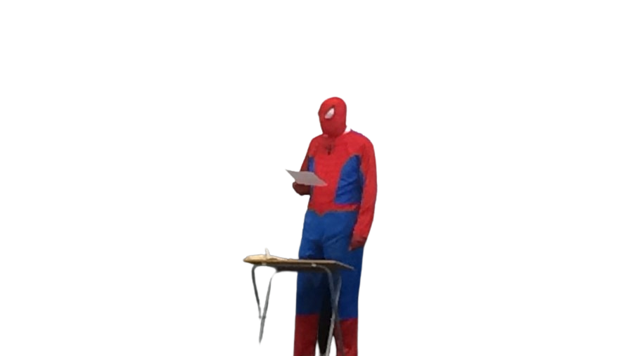

C044- Amishi Desai
C049- Chahel Gupta

